Slide 1
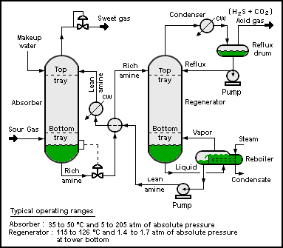
Note: This is the area you want to highlight.

Slide 2

Note: This is the spotlight created by the plugin.

Slide 3
